Slide 1


Slide 2
Company name
Nickname + what we provide

Slide 3


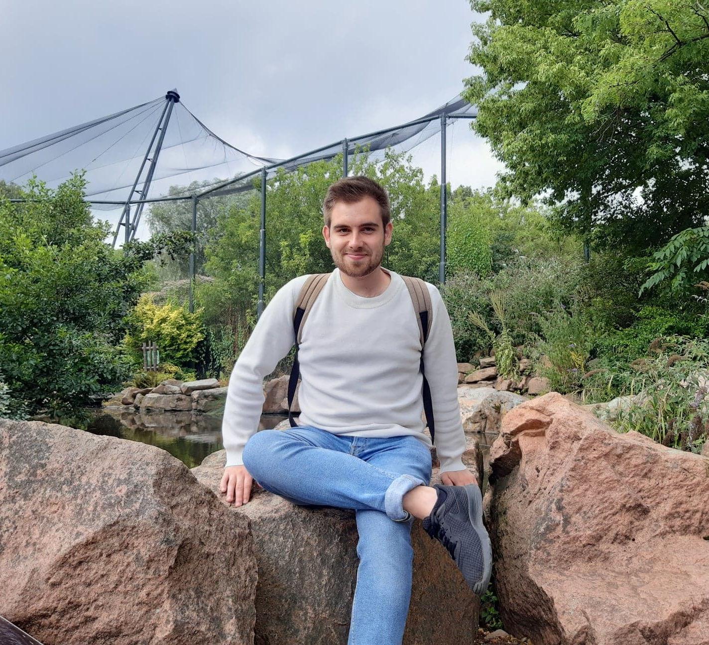
The manager
Three main qualities:
Vision
Integrity
Decisive

Slide 4

Departments
Front-end
Back-end
IoT
Marketing
Human resources

Slide 5

Specialities
web apps and websites where we really make a difference

Slide 6

Activities
Develop new applications
Maintain old projects
Courses

Slide 7
Most important customers
All customers are equally as valuable!

Slide 8

Market share
Now: +/-15% Future: ↑

Slide 9
New workers profile
Team player
Motivated
Creative
HTML 5
CSS3
JavaScript

